Slide 1

SALES FINANCIAL DASHBOARD SUMMARY REPORT
ARIJEET MUKHERJEE
| ELEVATE LAB DATA ANALYTICS INTERNSHIP TASK 3 |
25.09.2025

Slide 2
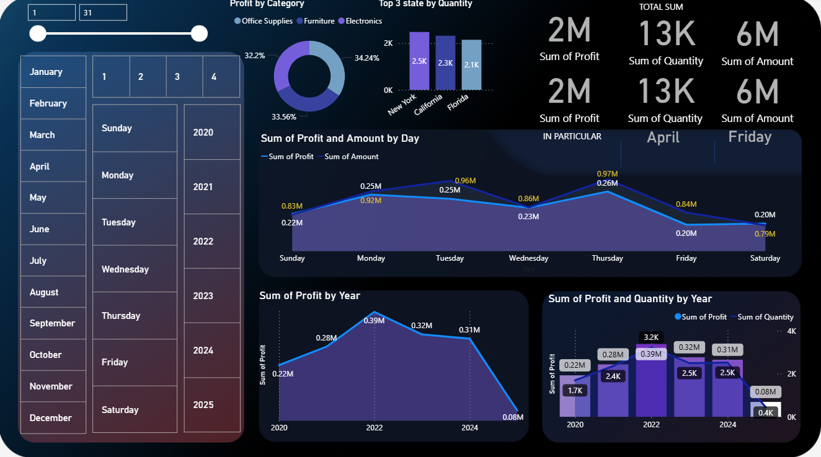
OUR BIG IDEA
THIS IS THE SALES DASHBOARD WE ARE GOING TO DISCUSS IN THE UPCOMING SLIDE

Slide 3

ABOUT DATASET
Order ID | Amount | Profit | Quantity | Order Date
Unique alphanumeric identifier for each order | sales amount for the record | profit associated with the record | number of units sold | transaction date in M/D/YYYY format
Category | Sub-Category | Payment Mode | State/ City | Year-Month
top‑level product group | specific product type within the category | payment method used | US States and City’s | derived period key in YYYY‑MM from Order Date for monthly grouping

Slide 4
VISUALIZATION USED:-
1. Range slicer for day-of-month with dual handles and input boxes (1–31).
6. Dual-series line chart: Sum of Profit and Sum of Amount by Day.
2. Vertical month slicer, numeric day tiles, weekday slicer, and year slicer (tile style).
7. Area/line chart of Sum of Profit by Year.
3. Donut chart for Profit by Category (Office Supplies, Furniture, Electronics)
8. Combo chart (clustered columns with line and secondary axis) for Profit and Quantity by Year.
4. Clustered column chart for Top 3 States by Quantity
5. KPI cards showing Sum of Profit, Sum of Quantity, and Sum of Amount, plus context cards reflecting selections

Slide 5

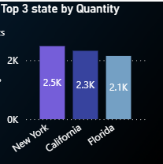
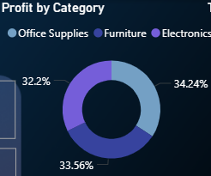
SUMMARY
ACTIONABLE TAKEAWAYS
Prioritize inventory and campaigns in New York and California to sustain volume growth, with Florida as a near‑term expansion opportunity.
Since profit shares are tightly clustered, use broad promotions while slightly favoring Office Supplies for marginal ROI gains.
Maintain service levels in the top states and keep monitoring category margins to preserve the current balance in profitability.
Office Supplies has the highest profit share at 34.24%, narrowly ahead of Furniture at 33.56% and Electronics at 32.20%.
The spread between the top and bottom categories is only about 2 percentage points, signaling a well‑balanced profit mix across the portfolio.
New York contributes 2,479 units topping the volume leaderboard among all states
California is close behind at 2,319 units.
Florida ranks third with 2,145 units.

Slide 6

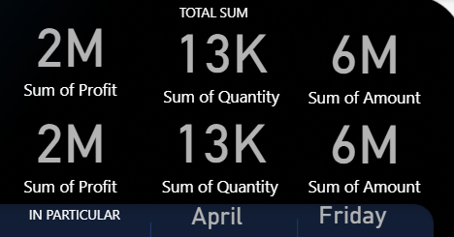
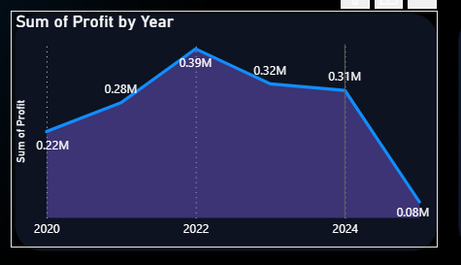
Sales Amount ≈ 6.18M; Profit ≈ 1.61M; Quantity ≈ 13K across all records. Implied overall profit margin is roughly 26% based on total profit relative to total amount, indicating healthy unit economics at the aggregate level.
Profit grows from 0.224M in 2020 to 0.283M in 2021 (+26% YoY) and 0.393M in 2022 (+39% YoY), marking the high point of the series. Profit eases to 0.322M in 2023 (-18% YoY) and 0.308M in 2024 (-4% YoY), signaling a post‑peak slowdown.
2025 shows 0.080M profit with transactions only in January, February, and March, so the annual total is incomplete at this point.
On a run‑rate basis, 2025 averages about 26.7K profit per month (0.080M over three months) versus roughly 25.7K per month in 2024 (0.308M over twelve), indicating a slightly stronger monthly pace despite partial‑year coverage

Slide 7
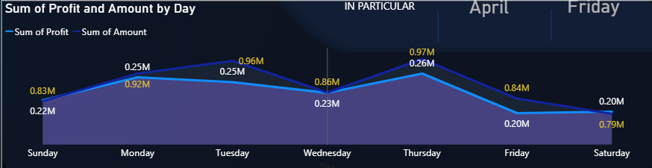
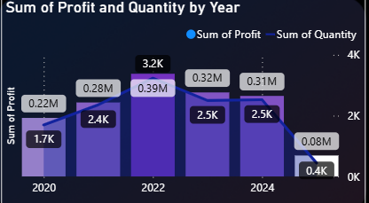

2022 is the top year: Profit ≈ 0.393M with 3,234 units, outpacing 2020–2021 and followed by a gradual cool‑off in 2023–2024.
Quantity tracks profit: units climb from 1,695 (2020) to 3,234 (2022) before easing to ~2,523 in 2024, indicating demand peaked alongside profitability. Thursday leads with the highest profit (~260.7K) and the largest sales amount (~966.9K), making it the prime day for launches and upsells. Friday underperforms relative to mid‑week, with profit dropping to ~198.3K and amount to ~842.4K, so discounts or targeted outreach could smooth the end‑week lull.
ACTIONABLE TAKEAWAYS
The weekly pattern rises from Sunday into a Tuesday–Thursday crest, then falls on Friday and stays lower on Saturday, pointing to a mid‑week demand concentration.
Align inventory, marketing, and support headcount to the Tuesday–Thursday window, and test Friday incentives to lift conversion heading into the weekend

Slide 8



THANK YOU!
Arijeet Mukherjee
arijeetm622@gmail.com

